Slide 1
Introduction to OpenMP
An Overview
[<number>]

Slide 2
What is Parallelization?
Parallelization
Simultaneous use of more than one processor to complete some work is parallelization of the work.
This work can be:
A collection of program statements
An algorithm
A part of program
The problem you are trying to solve
[<number>]

Slide 3
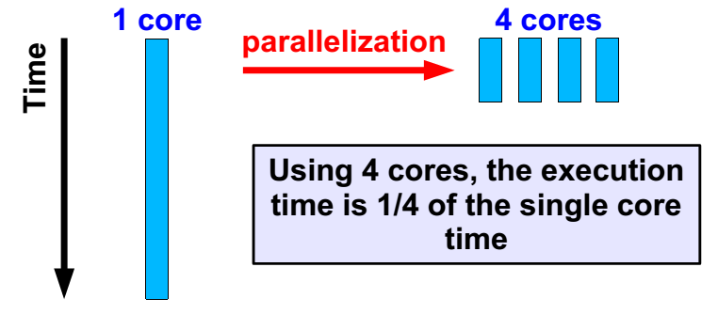
Why Parallelization ?
Parallelization is another optimization technique.
The goal is to reduce the execution time.
To this end, multiple processors, or cores, are used.
[<number>]

Slide 4
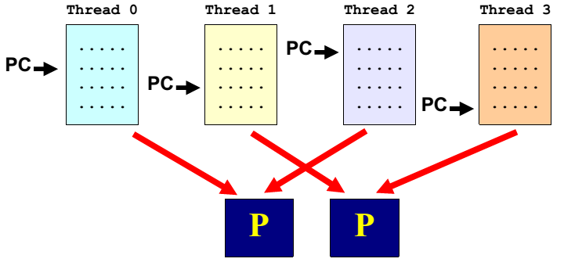
What is a Thread ?
Loosely said, a thread consists of a series of instructions with it's own program counter (“PC”) and state.
A parallel program executes threads in parallel.
These threads are then scheduled onto processors.
[<number>]

Slide 5
Parallel Overhead
Overhead is introduced during parallelization due to :
  Creation of threads(fork())
  Joining of threads (join())
  Thread synchronization and communication e.g. critical sections
  False sharing
Overhead increases with number of threads.
Efficient parallelization is minimizing this overheads.
[<number>]

Slide 6
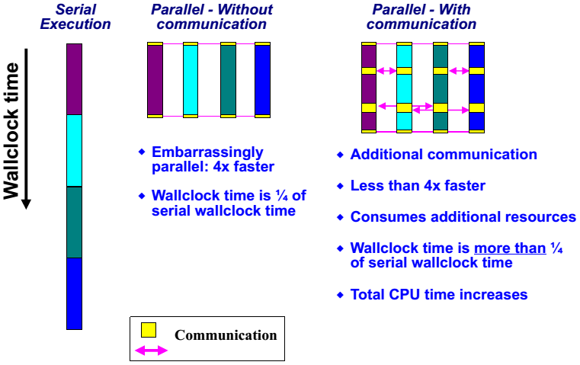
Communication
[<number>]

Slide 7
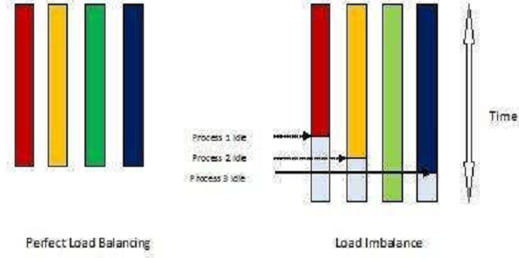
Load Balancing
In a perfectly balanced parallel program no set of processors is idle while other set of processors is doing some computation.
[<number>]

Slide 8
About scalability
Define the speed-up S(P) as S(P) := T(1)/T(P)
The efficiency E(P) is defined as E(P) := S(P)/P
In the ideal case, S(P)=P and E(P)=P/P=1=100%
Unless the application is embarrassingly parallel, S(P)
eventually starts to deviate from the ideal curve.
Past this point Popt, the application sees less and less benefit from adding processors.
Note that both metrics give no information on the actual run-time.
As such, they can be dangerous to use.
[<number>]

Slide 9
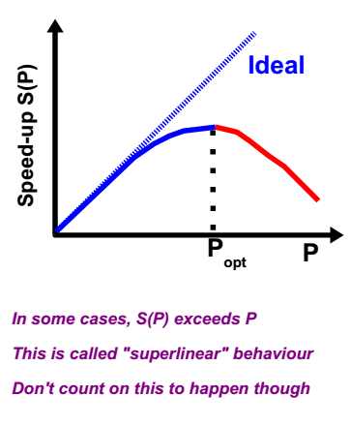
[<number>]

Slide 10
Amdahl's Law
Assume our program has a parallel fraction “f”
This implies the execution time T(1) := f*T(1) + (1-f)*T(1)
On P processors: T(P) = (f/P)*T(1) + (1-f)*T(1)
Amdahl's law:
Comments:
This "law' describes the effect the non-parallelizable part of a program has on scalability.
Note that the additional overhead caused by parallelization and speed-up because of cache effects are not taken into account.
[<number>]

Slide 11
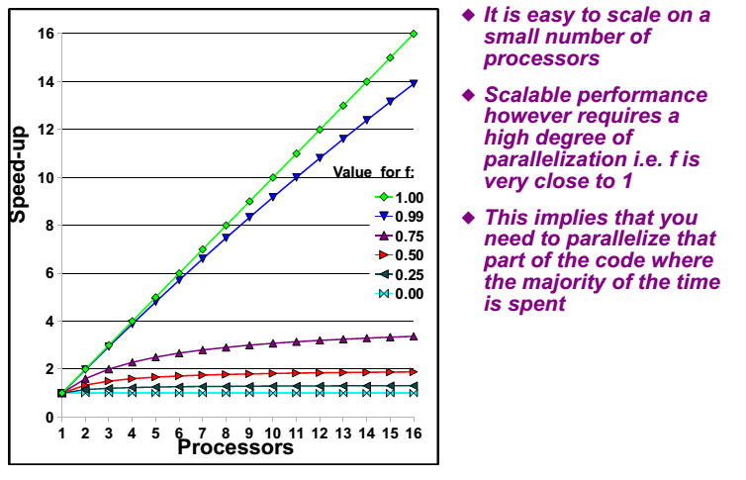
[<number>]

Slide 12

Amdahl's Law in practice
We can estimate the parallel fraction “f”
Recall: T(P) = (f/P)*T(1) + (1-f)*T(1)
It is trivial to solve this equation for “f”:
Example:
T(1) = 100 and T(4) = 37 => S(4) = T(1)/T(4) = 2.70
f = (1-37/100)/(1-(1/4)) = 0.63/0.75 = 0.84 = 84%
Estimated performance on 8 processors is then:
T(8) = (0.84/8)*100 + (1-0.84)*100 = 26.5
S(8) = T/T(8) = 3.78
[<number>]

Slide 13
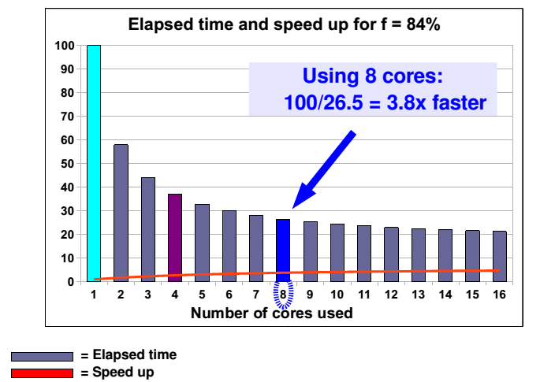
[<number>]

Slide 14
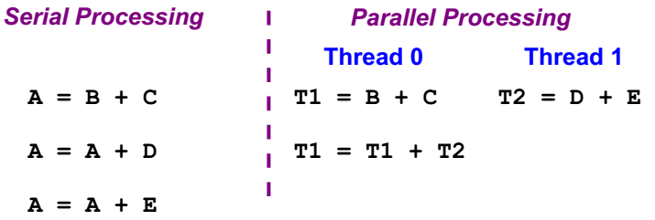
Numerical results
Consider:
A = B + C + D + E
The roundoff behavior is different and so the numerical results may be different too.
This is natural for parallel programs, but it may be hard to differentiate it from an ordinary bug ....
[<number>]

Slide 15
Overview to OpenMP
What is OpenMP ?
An API that may be used to explicitly direct multi-threaded, shared memory parallelism.
When to use OpenMP for parallelism ?
  A loop is not parallelized.
The data dependence analysis is not able to determine whether it is safe to parallelize or not.
  The Granularity is not enough.
The compiler lacks information to parallelize at highest possible level.
[<number>]

Slide 16
Why OpenMP ?
OpenMP Is:
An Application Program Interface (API) that may be used
to explicitly direct multi-threaded, shared memory
Parallelism.
Comprised of three primary API components:
  Compiler Directives
  Runtime Library Routines
  Environment Variables
Portable:
  The API is specified for C/C++ and Fortran.
  Most major platforms have been implemented
  including Unix/Linux platforms and Windows NT.
[<number>]

Slide 17
Standardized:
  Jointly defined and endorsed by a group of major computer hardware and software vendors
  Expected to become an ANSI standard later???
What does OpenMP stand for?
  Short version: Open Multi-Processing
  Long version: Open specifications for Multi-Processing via collaborative work between interested parties from the hardware and software industry, government and academia.
[<number>]

Slide 18
OpenMP Is Not:
Meant for distributed memory parallel systems (by itself).
Necessarily implemented identically by all vendors.
Guaranteed to make the most efficient use of
shared memory.
Required to check for data dependencies,
data conflicts, race conditions, or deadlocks.
Required to check for code sequences that cause a
program to be classified as non-conforming.
[<number>]

Slide 19
Meant to cover compiler-generated automatic
parallelization and directives to the compiler to
assist such parallelization.
Designed to guarantee that input or output to the same file is synchronous when executed in parallel. The programmer is responsible for synchronizing input and output.
[<number>]

Slide 20
Goals of OpenMP
Standardization:
Provide a standard among a variety of shared memory
architectures/platforms.
Lean and Mean:
Establish a simple and limited set of directives for
programming shared memory machines.
Significant parallelism can be implemented by using
just 3 or 4 directives.
[<number>]

Slide 21
Ease of Use:
Provide capability to incrementally parallelize a
serial program, unlike message-passing libraries
which typically require an all or nothing approach.
Provide the capability to implement both coarse-grain and fine-grain parallelism
Portability:
Supports Fortran (77, 90, and 95), C, and C++
Public forum for API and membership
[<number>]

Slide 22
History:
In the early 90's, vendors of shared-memory machines
supplied similar, directive-based, Fortran programming
extensions:
  The user would augment a serial Fortran program with
directives specifying which loops were to be parallelized.
  The compiler would be responsible for automatically
parallelizing such loops across the SMP processors.
Implementations were all functionally similar, but were
diverging (as usual).
First attempt at a standard was the draft for ANSI X3H5
in 1994. It was never adopted, largely due to waning
interest as distributed memory machines became popular.
[<number>]

Slide 23
However, not long after this, newer shared memory machine architectures started to become prevalent, and interest resumed.
The OpenMP standard specification started in the spring of 1997, taking over where ANSI X3H5 had left off.
Led by the OpenMP Architecture Review Board (ARB).
For more news and membership information about the OpenMP ARB, visit: openmp.org/wp/about-openmp
[<number>]

Slide 24
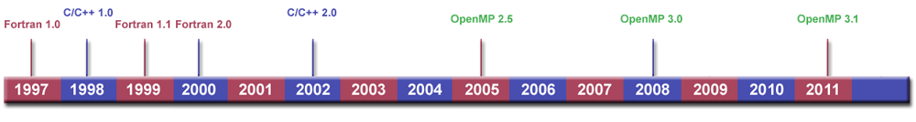
Release History
OpenMP continues to evolve, with new constructs and
features being added over time.
Initially, the API specifications were released separately
for C and Fortran. Since 2005, they have been released
together.
The time line below chronicles the OpenMP API
release history.
[<number>]

Slide 25
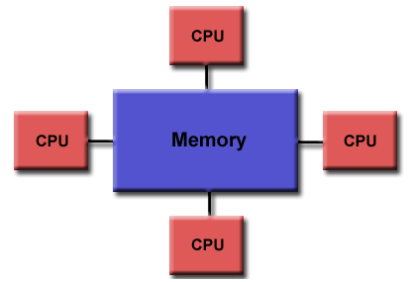
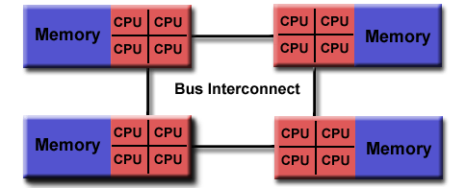
OpenMP Programming Model
Shared Memory Model:
OpenMP is designed for multi-processor/core, shared
memory machines. The underlying architecture can be
shared memory UMA or NUMA.
Uniform memory access Non-Uniform memory access
[<number>]

Slide 26
Thread Based Parallelism:
OpenMP programs accomplish parallelism exclusively through the use of threads.
A thread of execution is the smallest unit of processing that can be scheduled by an operating system. The idea of a subroutine that can be scheduled to run autonomously might help explain what a thread is.
Threads exist within the resources of a single process. Without the process, they cease to exist.
Typically, the number of threads match the number of machine processors/cores. However, the actual use of threads is up to the application.
[<number>]

Slide 27
Explicit Parallelism:
OpenMP is an explicit (not automatic) programming model, offering the programmer full control over parallelization.
Parallelization can be as simple as taking a serial program and inserting compiler directives....
Or as complex as inserting subroutines to set multiple levels of parallelism, locks and even nested locks.
[<number>]

Slide 28
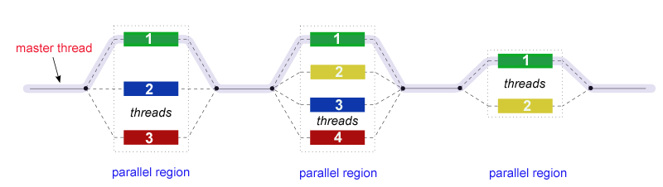
Fork - Join Model:
OpenMP uses the fork-join model of parallel execution:
All OpenMP programs begin as a single process: the
master thread. The master thread executes sequentially.
until the first parallel region construct is encountered.
FORK: the master thread then creates a team of parallel
threads.
[<number>]

Slide 29
The statements in the program that are enclosed by the parallel region construct are then executed in parallel among the various team threads
JOIN: When the team threads complete the statements in the parallel region construct, they synchronize and terminate, leaving only the master thread
Compiler Directive Based:
Most OpenMP parallelism is specified through the use of compiler directives which are imbedded in C/C++ or Fortran source code.
[<number>]

Slide 30
Nested Parallelism Support:
The API provides for the placement of parallel constructs
inside of other parallel constructs.
Implementations may or may not support this feature.
Dynamic Threads:
The API provides for dynamically altering the number of
threads which may used to execute different parallel regions.
Implementations may or may not support this feature.
[<number>]

Slide 31
I/O:
OpenMP specifies nothing about parallel I/O. This is
particularly important if multiple threads attempt to write/read
from the same file.
If every thread conducts I/O to a different file, the issues are not as significant.
It is entirely up to the programmer to insure that I/O is conducted correctly within the context of a multi-threaded program.
[<number>]

Slide 32
Memory Model: FLUSH Often?
OpenMP provides a "relaxed-consistency" and "temporary" view of thread memory (in their words). In other words, threads can "cache" their data and are not required to maintain exact consistency with real memory all of the time.
When it is critical that all threads view a shared variable identically, the programmer is responsible for insuring that the variable is FLUSHed by all threads as needed.
[<number>]

Slide 33
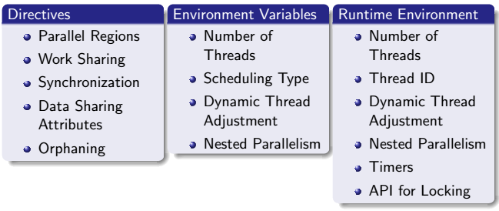
Components of OpenMP
OpenMP consists of a set of compiler directives, library routines, and environment variables that influence run-time behavior.
[<number>]

Slide 34
Compiler Directives:
Compiler directives appear as comments in your source code and are ignored by compilers unless you tell them otherwise - usually by specifying the appropriate compiler flag.
OpenMP compiler directives are used for various purposes:
  Spawning a parallel region
  Dividing blocks of code among threads
  Distributing loop iterations between threads
  Serializing sections of code
  Synchronization of work among threads
[<number>]

Slide 35
Compiler directives have the following syntax:
sentinel directive-name [clause, ...]
For example:
Fortran | !$OMP PARALLEL DEFAULT(SHARED) PRIVATE(BETA,PI)
C/C++ | #pragma omp parallel default(shared) private(beta,pi)
[<number>]

Slide 36
Run-time Library Routines:
The OpenMP API includes an ever-growing number of
run-time library routines.
These routines are used for a variety of purposes:
  Setting and querying the number of threads
  Querying a thread's unique identifier (thread ID),
  a thread's ancestor's identifier, the thread team size
  Setting and querying the dynamic threads feature
  Querying if in a parallel region, and at what level
  Setting and querying nested parallelism
  Setting, initializing and terminating locks and nested
  locks
  Querying wall clock time and resolution
[<number>]

Slide 37
For C/C++, all of the run-time library routines are actual subroutines. For Fortran, some are actually functions, and some are subroutines. For example:
Fortran | INTEGER FUNCTION OMP_GET_NUM_THREADS()
C/C++ | #include <omp.h> int omp_get_num_threads(void)
Note that for C/C++, you usually need to include the
<omp.h> header file.
Fortran routines are not case sensitive, but C/C++
routines are.
[<number>]

Slide 38
Environment Variables:
OpenMP provides several environment variables for
controlling the execution of parallel code at run-time.
These environment variables can be used to control
such things as:
  Setting the number of threads
  Specifying how loop interations are divided
  Binding threads to processors
  Enabling/disabling nested parallelism;
  setting the maximum levels of nested parallelism
  Enabling/disabling dynamic threads
  Setting thread stack size
  Setting thread wait policy
[<number>]

Slide 39
Setting OpenMP environment variables is done the same way you set any other environment variables, and depends upon which shell you use. For example:
csh/tcsh | setenv OMP_NUM_THREADS 8
sh/bash | export OMP_NUM_THREADS=8
[<number>]

Slide 40
Example OpenMP Code Structure:
Fortran - General Code Structure
PROGRAM HELLO
INTEGER VAR1, VAR2, VAR3
Serial code . . .
Beginning of parallel section. Fork a team of threads.
Specify variable scoping
!$OMP PARALLEL PRIVATE(VAR1, VAR2) SHARED(VAR3)
  Parallel section executed by all threads .
  Other OpenMP directives .
  Run-time Library calls .
  All threads join master thread and disband
!$OMP END PARALLEL
Resume serial code . . .
END
[<number>]

Slide 41
C / C++ - General Code Structure
#include <omp.h>
main () {
int var1, var2, var3;
Serial code . . .
Beginning of parallel section. Fork a team of threads. Specify variable scoping
#pragma omp parallel private(var1, var2) shared(var3)
  {
  Parallel section executed by all threads .
  Other OpenMP directives .
  Run-time Library calls .
  All threads join master thread and disband
  }
Resume serial code . . .
}
[<number>]

Slide 42
Compiling OpenMP Programs
LC OpenMP Implementations:
OpenMP 2.0 is supported by all of LC's Linux cluster
compilers.
As of June 2012, it appears that the most recent versions
of the Intel, PGI and GNU compilers do not fully support
OpenMP 3.0 or 3.1. Some features do appear to be
supported however, depending upon the compiler and version.
Use the command use -l compilers to view compiler
packages by version.
[<number>]

Slide 43
Compiling:
All of LC's compilers require you to use the appropriate compiler flag to "turn on" OpenMP compilations. The table below shows what to use for each compiler.
Compiler / Platform | Compiler | Flag
Intel Linux Opteron/Xeon | icc icpc ifort | -openmp
PGI Linux Opteron/Xeon | pgcc pgCC pgf77 pgf90 | -mp
GNU Linux Opteron/Xeon IBM Blue Gene | gcc g++ g77 gfortran | -fopenmp
IBM Blue Gene | bgxlc_r, bgcc_r bgxlC_r, bgxlc++_r bgxlc89_r bgxlc99_r bgxlf_r bgxlf90_r bgxlf95_r bgxlf2003_r *Be sure to use a thread-safe compiler - its name ends with _r | -qsmp=omp
[<number>]

Slide 44
OpenMP Directives
Fortran Directives Format
Format: (case insensitive)
sentinel | directive-name | [clause ...]
All Fortran OpenMP directives must begin with a sentinel. The accepted sentinels depend upon the type of Fortran source. Possible sentinels are: !$OMP C$OMP *$OMP | A valid OpenMP directive. Must appear after the sentinel and before any clauses. | Optional. Clauses can be in any order, and repeated as necessary unless otherwise restricted.
[<number>]

Slide 45
Example:
!$OMP PARALLEL DEFAULT(SHARED) PRIVATE(BETA,PI)
General Rules:
  Comments can not appear on the same line as a directive.
  Only one directive-name may be specified per directive.
  Fortran compilers which are OpenMP enabled generally include a command line option which instructs the compiler to activate and interpret all OpenMP directives.
[<number>]

Slide 46
  Several Fortran OpenMP directives come in pairs and have the form shown below. The "end" directive is optional but advised for readability.
!$OMP directive
[ structured block of code ]
!$OMP end directive
[<number>]

Slide 47
C / C++ Directives Format
Format:
#pragma omp | directive-name | [clause, ...] | newline
Required for all OpenMP C/C++ directives. | A valid OpenMP directive. Must appear after the pragma and before any clauses. | Optional. Clauses can be in any order, and repeated as necessary unless otherwise restricted. | Required. Precedes the structured block which is enclosed by this directive.
Example:
#pragma omp parallel default(shared) private(beta,pi)
[<number>]

Slide 48
General Rules:
  Case sensitive
  Directives follow conventions of the C/C++ standards for compiler directives
  Only one directive-name may be specified per directive
  Each directive applies to at most one succeeding statement, which must be a structured block.
  Long directive lines can be "continued" on succeeding lines by escaping the newline character with a backslash ("\") at the end of a directive line.
[<number>]

Slide 49
PARALLEL Region Construct
Purpose:
A parallel region is a block of code that will be executed
by multiple threads. This is the fundamental OpenMP
parallel construct.
Format:
Fortran | !$OMP PARALLEL [clause ...] IF (scalar_logical_expression) PRIVATE (list) SHARED (list) DEFAULT (PRIVATE | FIRSTPRIVATE | SHARED | NONE) FIRSTPRIVATE (list) REDUCTION (operator: list) COPYIN (list) NUM_THREADS (scalar-integer-expression) block !$OMP END PARALLEL
[<number>]

Slide 50
C/C++ | #pragma omp parallel [clause ...] newline if (scalar_expression) private (list) shared (list) default (shared | none) firstprivate (list) reduction (operator: list) copyin (list) num_threads (integer-expression) structured_block
[<number>]

Slide 51
Notes:
When a thread reaches a PARALLEL directive, it creates a team of threads and becomes the master of the team. The master is a member of that team and has thread number 0 within that team.
Starting from the beginning of this parallel region, the code is duplicated and all threads will execute that code.
There is an implied barrier at the end of a parallel section. Only the master thread continues execution past this point.
If any thread terminates within a parallel region, all threads in the team will terminate, and the work done up until that point is undefined.
[<number>]

Slide 52
How Many Threads?
The number of threads in a parallel region is determined by
the following factors, in order of precedence:
  Evaluation of the IF clause
  Setting of the NUM_THREADS clause
  Use of the omp_set_num_threads() library function
  Setting of the OMP_NUM_THREADS environment
  variable
  Implementation default - usually the number of CPUs
  on a node, though it could be dynamic (see next bullet).
Threads are numbered from 0 (master thread) to N-1
[<number>]

Slide 53
Dynamic Threads:
Use the omp_get_dynamic() library function to determine if dynamic
threads are enabled.
If supported, the two methods available for enabling dynamic threads are:
  The omp_set_dynamic() library routine
  Setting of the OMP_DYNAMIC environment variable to TRUE
Nested Parallel Regions:
Use the omp_get_nested() library function to determine if nested parallel
regions are enabled.
The two methods available for enabling nested parallel regions
(if supported) are:
  The omp_set_nested() library routine
  Setting of the OMP_NESTED environment variable to TRUE
[<number>]

Slide 54
If not supported, a parallel region nested within another parallel region results in the creation of a new team, consisting of one thread, by default.
Clauses:
IF clause: If present, it must evaluate to .TRUE. (Fortran) or non-zero (C/C++) in order for a team of threads to be created. Otherwise, the region is executed serially by the master thread.
Restrictions:
A parallel region must be a structured block that does not span multiple routines or code files.
It is illegal to branch (goto) into or out of a parallel region.
Only a single IF clause is permitted.
Only a single NUM_THREADS clause is permitted.
[<number>]

Slide 55
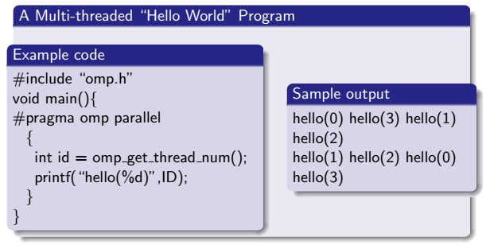
Example 1
[<number>]

Slide 56
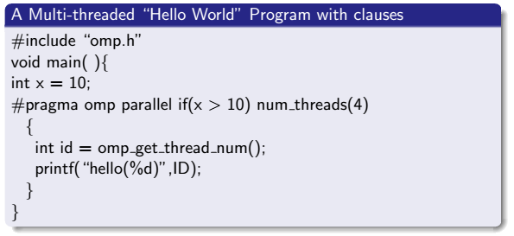
Example 2
num_threads clause to request certain no of threads
omp_get_thread_num() runtime function to return thread ID
[<number>]

Slide 57
How does it work ?
When a thread reaches a parallel directive, it creates a team
of threads and becomes the master of the team.
The master thread always have ID 0 and it is the part of team
There is an implied barrier at the end of parallel section.
Thread adjustment (if enabled) is only done before entering a
parallel region
Parallel regions can be nested depends on implementation.
An ”if” clause can be used to guard the parallel region
It is illegal to branch in or out of parallel region
Only a single IF or NUM THREADS clause is permitted
[<number>]

Slide 58
Work-Sharing Constructs
A work-sharing construct divides the execution of the enclosed code region among the members of the team that encounter it.
Work-sharing constructs do not launch new threads
There is no implied barrier upon entry to a work-sharing construct, however there is an implied barrier at the end of a work sharing construct.
[<number>]

Slide 59
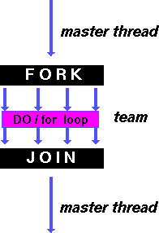
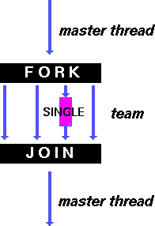
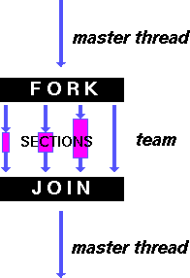
Types of Work-Sharing Constructs:
DO / for - shares iterations of a loop across the team. Represents a type of "data parallelism". | SECTIONS - breaks work into separate, discrete sections. Each section is executed by a thread. Can be used to implement a type of "functional parallelism". | SINGLE - serializes a section of code
[<number>]

Slide 60
Restrictions:
A work-sharing construct must be enclosed dynamically within a parallel region in order for the directive to execute in parallel.
Work-sharing constructs must be encountered by all members of a team or none at all.
Successive work-sharing constructs must be encountered in the same order by all members of a team.
[<number>]

Slide 61
Work-Sharing Constructs DO / for Directive
Purpose:
The DO / for directive specifies that the iterations of the loop
immediately following it must be executed in parallel by the team.
This assumes a parallel region has already been initiated, otherwise it
executes in serial on a single processor.
Format:
C/C++ | #pragma omp for [clause ...] newline schedule (type [,chunk]) ordered private (list) firstprivate (list) lastprivate (list) shared (list) reduction (operator: list) collapse (n) nowait for_loop
[<number>]

Slide 62
Clauses:
SCHEDULE: Describes how iterations of the loop are divided
among the threads in the team. The default schedule is
implementation dependent.
STATIC
  Loop iterations are divided into pieces of size chunk and then
  statically assigned to threads. If chunk is not specified, the iterations
  are evenly (if possible) divided contiguously among the threads.
DYNAMIC
  Loop iterations are divided into pieces of size chunk, and dynamically
  scheduled among the threads; when a thread finishes one chunk,
  it is dynamically assigned another. The default chunk size is 1.
[<number>]

Slide 63
GUIDED
  Iterations are dynamically assigned to threads in blocks as threads
  request them until no blocks remain to be assigned. Similar to DYNAMIC except that the block size decreases each time a parcel of work is given to a thread. The size of the initial block is proportional to: number_of_iterations / number_of_threads
  Subsequent blocks are proportional to number_of_iterations_remaining / number_of_threads
  The chunk parameter defines the minimum block size. The default chunk size is 1.
RUNTIME
  The scheduling decision is deferred until runtime by the environment variable OMP_SCHEDULE. It is illegal to specify a chunk size for this clause.
AUTO
  The scheduling decision is delegated to the compiler and/or runtime system.
[<number>]

Slide 64
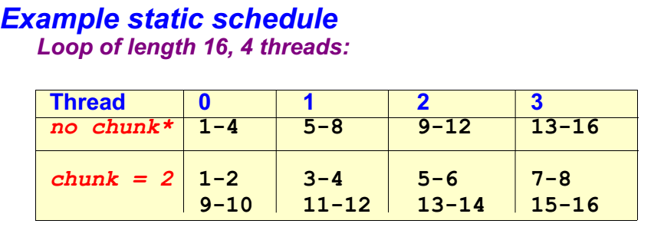
[<number>]

Slide 65
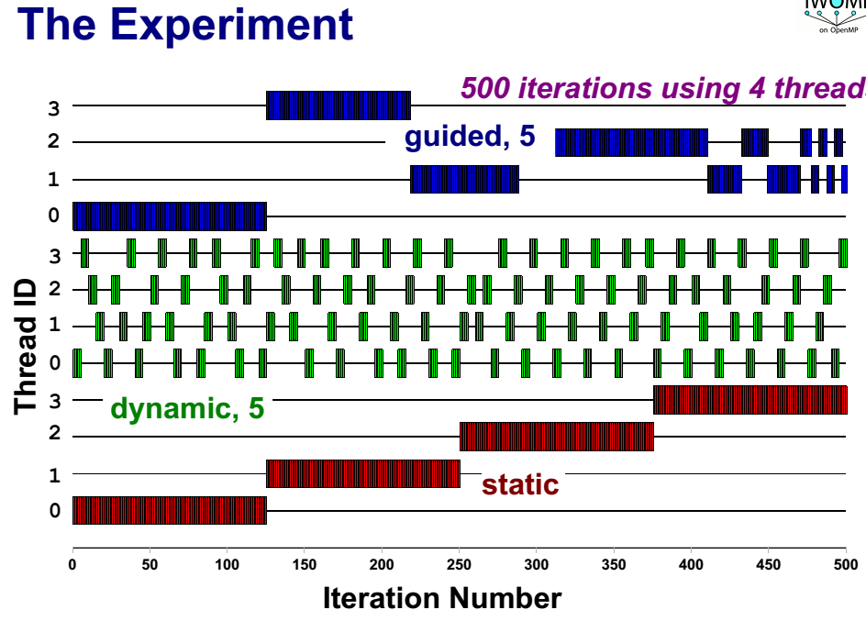
[<number>]

Slide 66
NO WAIT / nowait: If specified, then threads do not synchronize at the end of the parallel loop.
ORDERED: Specifies that the iterations of the loop must be executed as they would be in a serial program.
COLLAPSE: Specifies how many loops in a nested loop should be collapsed into one large iteration space and divided according to the schedule clause. The sequential execution of the iterations in all associated loops determines the order of the iterations in the collapsed iteration space.
[<number>]

Slide 67
Restrictions:
The DO loop can not be a DO WHILE loop, or a loop without loop control.
Also, the loop iteration variable must be an integer and the loop control
parameters must be the same for all threads.
Program correctness must not depend upon which thread executes a
particular iteration.
It is illegal to branch (goto) out of a loop associated with a DO/for directive.
The chunk size must be specified as a loop invarient integer expression,
as there is no synchronization during its evaluation by different threads.
ORDERED, COLLAPSE and SCHEDULE clauses may appear once each.
See the OpenMP specification document for additional restrictions.
[<number>]

Slide 68
Example: for Directive
Simple vector-add program
  Arrays A, B, C, and variable N will be shared by all threads.
  Variable I will be private to each thread; each thread will have its own unique copy.
  The iterations of the loop will be distributed dynamically in CHUNK sized pieces.
  Threads will not synchronize upon completing their individual pieces of work (NOWAIT).
[<number>]

Slide 69
#include <omp.h>
#define CHUNKSIZE 100
#define N 1000
main ()
{
int i, chunk; float a[N], b[N], c[N];
/* Some initializations */
for (i=0; i < N; i++)
a[i] = b[i] = i * 1.0;
chunk = CHUNKSIZE;
#pragma omp parallel shared(a,b,c,chunk) private(i)
{
#pragma omp for schedule(dynamic,chunk) nowait
for (i=0; i < N; i++)
c[i] = a[i] + b[i];
}
/* end of parallel section */
}
[<number>]

Slide 70
Work-Sharing Constructs SECTIONS Directive
Purpose:
The SECTIONS directive is a non-iterative work-sharing construct. It specifies that the enclosed section(s) of code are to be divided among the threads in the team.
Independent SECTION directives are nested within a SECTIONS directive. Each SECTION is executed once by a thread in the team. Different sections may be executed by different threads. It is possible for a thread to execute more than one section if it is quick enough and the implementation permits such.
[<number>]

Slide 71
Format:
C/C++ | #pragma omp sections [clause ...] newline private (list) firstprivate (list) lastprivate (list) reduction (operator: list) nowait { #pragma omp section newline structured_block #pragma omp section newline structured_block }
[<number>]

Slide 72
Clauses:
There is an implied barrier at the end of a SECTIONS directive, unless the
NOWAIT/nowait clause is used.
Restrictions:
It is illegal to branch (goto) into or out of section blocks.
SECTION directives must occur within the lexical extent of an enclosing SECTIONS directive (no orphan SECTIONs).
[<number>]

Slide 73
Example: SECTIONS Directive
Simple program demonstrating that different blocks of work will be done by different threads.
#include <omp.h>
#define N 1000
main ()
{
int i;
float a[N], b[N], c[N], d[N];
/* Some initializations */
for (i=0; i < N; i++){
a[i] = i * 1.5;
b[i] = i + 22.35;
}
[<number>]

Slide 74
#pragma omp parallel shared(a,b,c,d) private(i)
{
#pragma omp sections nowait
{
#pragma omp section
for (i=0; i < N; i++)
c[i] = a[i] + b[i];
#pragma omp section
for (i=0; i < N; i++)
d[i] = a[i] * b[i];
} /* end of sections */
}/* end of parallel section */
}
[<number>]

Slide 75
Work-Sharing Constructs WORKSHARE Directive
Purpose:
Fortran only
The WORKSHARE directive divides the execution of the enclosed structured block into separate units of work, each of which is executed only once.
The structured block must consist of only the following:
  array assignments scalar assignments
  FORALL statements FORALL constructs
  WHERE statements WHERE constructs
  atomic constructs critical constructs
  parallel constructs
[<number>]

Slide 76
Format:
Fortran | !$OMP WORKSHARE structured block !$OMP END WORKSHARE [ NOWAIT ]
Restrictions:
The construct must not contain any user defined function calls unless the function is ELEMENTAL.
Example: WORKSHARE Directive
Simple array and scalar assignments shared by the team of threads. A unit of work would include:
  Any scalar assignment
  For array assignment statements, the assignment of each element is a unit of work
[<number>]

Slide 77
PROGRAM WORKSHARE
INTEGER N, I, J
PARAMETER (N=100)
REAL AA(N,N), BB(N,N), CC(N,N), DD(N,N), FIRST, LAST
! Some initializations
DO I = 1, N
DO J = 1, N
AA(J,I) = I * 1.0
BB(J,I) = J + 1.0
ENDDO
ENDDO
!$OMP PARALLEL SHARED(AA,BB,CC,DD,FIRST,LAST)
!$OMP WORKSHARE
CC = AA * BB
DD = AA + BB
FIRST = CC(1,1) + DD(1,1)
LAST = CC(N,N) + DD(N,N)
!$OMP END WORKSHARE NOWAIT
!$OMP END PARALLEL
END
[<number>]

Slide 78
Work-Sharing Constructs SINGLE Directive
Purpose:
The SINGLE directive specifies that the enclosed code is to be executed by only one thread in the team.
May be useful when dealing with sections of code that are not thread safe (such as I/O)
Format:
C/C++ | #pragma omp single [clause ...] newline private (list) firstprivate (list) nowait structured_block
[<number>]

Slide 79
Clauses:
Threads in the team that do not execute the SINGLE directive,
wait at the end of the enclosed code block, unless a NOWAIT/nowait
clause is specified.
Restrictions:
It is illegal to branch into or out of a SINGLE block.
[<number>]

Slide 80
Combined Parallel Work-Sharing Constructs
OpenMP provides three directives that are merely conveniences:
  PARALLEL DO / parallel for
  PARALLEL SECTIONS
  PARALLEL WORKSHARE (fortran only)
For the most part, these directives behave identically to an individual PARALLEL directive being immediately followed by a separate work-sharing directive.
Most of the rules, clauses and restrictions that apply to both directives are in effect. See the OpenMP API for details.
An example using the PARALLEL DO / parallel for combined directive is shown below.
[<number>]

Slide 81
C / C++ - parallel for Directive Example
#include <omp.h>
#define N 1000
#define CHUNKSIZE 100
main (){
int i, chunk;
float a[N], b[N], c[N];
/* Some initializations */
for (i=0; i < N; i++)
a[i] = b[i] = i * 1.0;
chunk = CHUNKSIZE;
#pragma omp parallel for \
shared(a,b,c,chunk) private(i) \
schedule(static,chunk)
for (i=0; i < n; i++)
c[i] = a[i] + b[i];
}
[<number>]

Slide 82
TASK Construct
Purpose:
New construct with OpenMP 3.0
The TASK construct defines an explicit task, which may be executed by the encountering thread, or deferred for execution by any other thread in the team.
The data environment of the task is determined by the data sharing attribute clauses.
Task execution is subject to task scheduling.
[<number>]

Slide 83
Format:
C/C++ | #pragma omp task [clause ...] newline if (scalar expression) final (scalar expression) untied default (shared | none) mergeable private (list) firstprivate (list) shared (list) structured_block
[<number>]

Slide 84
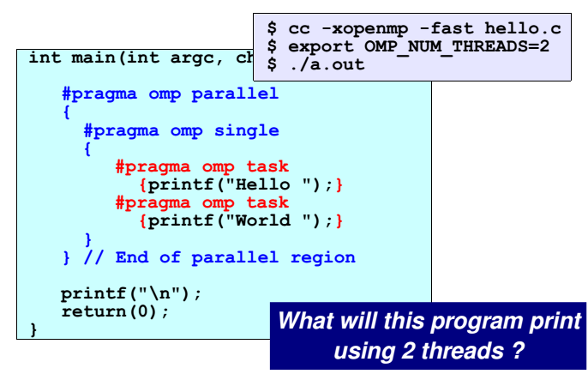
[<number>]

Slide 85
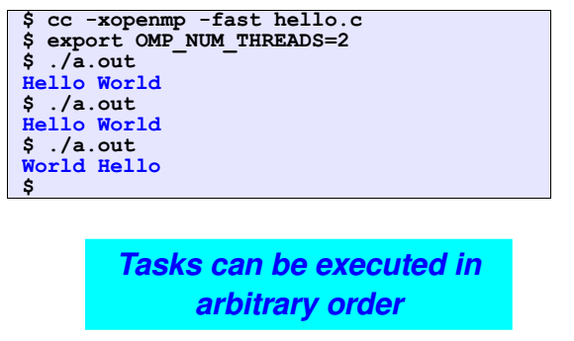
[<number>]

Slide 86
Synchronization Constructs
Consider a simple example where two threads on two different processors are both trying to increment a variable x at the same time (assume x is initially 0):
THREAD 1: increment(x) { x = x + 1; } THREAD 1: 10 LOAD A, (x address) 20 ADD A, 1 30 STORE A, (x address) | THREAD 2: increment(x) { x = x + 1; } THREAD 2: 10 LOAD A, (x address) 20 ADD A, 1 30 STORE A, (x address)
[<number>]

Slide 87
One possible execution sequence:
  Thread 1 loads the value of x into register A.
  Thread 2 loads the value of x into register A.
  Thread 1 adds 1 to register A
  Thread 2 adds 1 to register A
  Thread 1 stores register A at location x
  Thread 2 stores register A at location x
The resultant value of x will be 1, not 2 as it should be.
To avoid a situation like this, the incrementing of x must be synchronized between the two threads to ensure that the correct result is produced.
OpenMP provides a variety of Synchronization Constructs that control how the execution of each thread proceeds relative to other team threads.
[<number>]

Slide 88
Synchronization Constructs MASTER Directive
Purpose:
The MASTER directive specifies a region that is to be executed only by
the master thread of the team. All other threads on the team skip this
section of code.
There is no implied barrier associated with this directive.
Format:
C/C++ | #pragma omp master newline structured_block
Restrictions:
It is illegal to branch into or out of MASTER block.
[<number>]

Slide 89
Synchronization Constructs CRITICAL Directive
Purpose:
The CRITICAL directive specifies a region of code that must be executed
by only one thread at a time.
Format:
C/C++ | #pragma omp critical [ name ] newline structured_block
Notes:
If a thread is currently executing inside a CRITICAL region and another thread reaches that CRITICAL region and attempts to execute it, it will block until the first thread exits that CRITICAL region.
The optional name enables multiple different CRITICAL regions to exist:
  Names act as global identifiers. Different CRITICAL regions with the same name are treated as the same region.
  All CRITICAL sections which are unnamed, are treated as the same section.
[<number>]

Slide 90
Restrictions:
It is illegal to branch into or out of a CRITICAL block.
Fortran only: The names of critical constructs are global entities of the program. If a name conflicts with any other entity, the behavior of the program is unspecified.
Example: CRITICAL Construct
All threads in the team will attempt to execute in parallel, however, because of the CRITICAL construct surrounding the increment of x, only one thread will be able to read/increment/write x at any time
[<number>]

Slide 91
C / C++ - critical Directive Example
#include <omp.h>
main()
{
int x; x = 0;
#pragma omp parallel shared(x)
{
#pragma omp critical
x = x + 1;
} /* end of parallel section */
}
[<number>]

Slide 92
Synchronization Constructs BARRIER Directive
Purpose:
The BARRIER directive synchronizes all threads in the team.
When a BARRIER directive is reached, a thread will wait at that point
until all other threads have reached that barrier. All threads then resume
executing in parallel the code that follows the barrier.
Format:
C/C++ | #pragma omp barrier newline
Restrictions:
All threads in a team (or none) must execute the BARRIER region.
The sequence of work-sharing regions and barrier regions encountered must be the same for every thread in a team.
[<number>]

Slide 93
Synchronization Constructs TASKWAIT Directive
Purpose:
New with OpenMP 3.0
The TASKWAIT construct specifies a wait on the completion of child
tasks generated since the beginning of the current task.
Format:
C/C++ | #pragma omp taskwait newline
Restrictions:
Because the taskwait construct does not have a C language statement as part of its syntax, there are some restrictions on its placement within a program. The taskwait directive may be placed only at a point where a base language statement is allowed. The taskwait directive may not be used in place of the statement following an if, while, do, switch, or label.
[<number>]

Slide 94
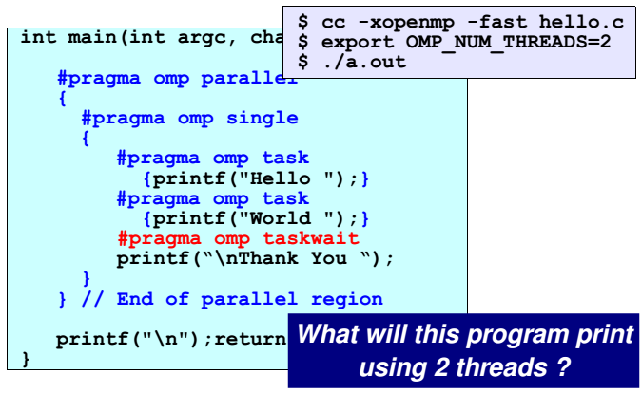
[<number>]

Slide 95
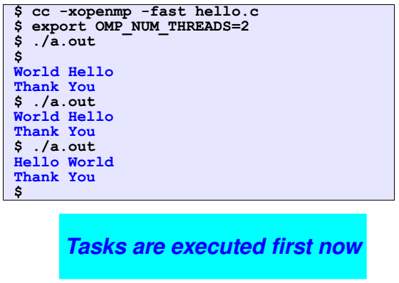
[<number>]

Slide 96
Synchronization Constructs ATOMIC Directive
Purpose:
The ATOMIC directive specifies that a specific memory location must be
updated atomically, rather than letting multiple threads attempt to write
to it. In essence, this directive provides a mini-CRITICAL section.
Format:
C/C++ | #pragma omp atomic newline statement_expression
Restrictions:
The directive applies only to a single, immediately following statement
An atomic statement must follow a specific syntax.
[<number>]

Slide 97
Synchronization Constructs ORDERED Directive
Purpose:
The ORDERED directive specifies that iterations of the enclosed loop will be executed in the same order as if they were executed on a serial processor.
Threads will need to wait before executing their chunk of iterations if previous iterations haven't completed yet.
Used within a DO / for loop with an ORDERED clause
The ORDERED directive provides a way to "fine tune" where ordering is to be applied within a loop. Otherwise, it is not required.
[<number>]

Slide 98
Format:
C/C++ | #pragma omp for ordered [clauses...] (loop region) #pragma omp ordered newline structured_block (endo of loop region)
TASKWAIT
[<number>]

Slide 99
Restrictions:
An ORDERED directive can only appear in the dynamic extent of the
following directives:
  DO or PARALLEL DO (Fortran)
  for or parallel for (C/C++)
Only one thread is allowed in an ordered section at any time
It is illegal to branch into or out of an ORDERED block.
An iteration of a loop must not execute the same ORDERED directive
more than once, and it must not execute more than one
ORDERED directive.
A loop which contains an ORDERED directive, must be a loop with an
ORDERED clause.
[<number>]

Slide 100
THREADPRIVATE Directive
Purpose:
The THREADPRIVATE directive is used to make global file scope
variables (C/C++) or common blocks (Fortran) local and persistent to a
thread through the execution of multiple parallel regions.
Format:
C/C++ | #pragma omp threadprivate (list)
Notes:
The directive must appear after the declaration of listed variables/common blocks. Each thread then gets its own copy of the variable/common block, so data written by one thread is not visible to other threads.
[<number>]

Slide 101
C/C++ - threadprivate Directive Example
#include<stdio.h>
#include <omp.h>
int a, b, i, tid;
float x;
#pragma omp threadprivate(a, x)
main () {
/* Explicitly turn off dynamic threads */
omp_set_dynamic(0);
printf("1st Parallel Region:\n");
#pragma omp parallel private(b,tid)
{
tid = omp_get_thread_num();
a = tid;
b = tid;
x = 1.1 * tid +1.0;
printf("Thread %d: a,b,x= %d %d %f\n",tid,a,b,x);
} /* end of parallel section */
[<number>]

Slide 102
printf("************************************\n");
printf("Master thread doing serial work here\n"); printf("************************************\n");
printf("2nd Parallel Region:\n");
#pragma omp parallel private(tid)
{
tid = omp_get_thread_num();
printf("Thread %d: a,b,x= %d %d %f\n",tid,a,b,x);
} /* end of parallel section */
}
[<number>]

Slide 103
Output:
1st Parallel Region:
Thread 0: a,b,x= 0 0 1.000000
Thread 2: a,b,x= 2 2 3.200000
Thread 3: a,b,x= 3 3 4.300000
Thread 1: a,b,x= 1 1 2.100000
************************************
Master thread doing serial work here
************************************
2nd Parallel Region:
Thread 0: a,b,x= 0 0 1.000000
Thread 3: a,b,x= 3 0 4.300000
Thread 1: a,b,x= 1 0 2.100000
Thread 2: a,b,x= 2 0 3.200000
[<number>]

Slide 104
On first entry to a parallel region, data in THREADPRIVATE variables
and common blocks should be assumed undefined, unless a COPYIN
clause is specified in the PARALLEL directive
THREADPRIVATE variables differ from PRIVATE variables
(discussed later) because they are able to persist between different
parallel sections of a code.
Restrictions:
Data in THREADPRIVATE objects is guaranteed to persist only if the
dynamic threads mechanism is "turned off" and the number of threads in
different parallel regions remains constant. The default setting of
dynamic threads is undefined.
The THREADPRIVATE directive must appear after every declaration
of a thread private variable/common block.
Fortran: only named common blocks can be made THREADPRIVATE.
[<number>]

Slide 105
Data Scope Attribute Clauses
Also called Data-sharing Attribute Clauses
An important consideration for OpenMP programming is the
understanding and use of data scoping
Because OpenMP is based upon the shared memory programming
model, most variables are shared by default
Global variables include:
Fortran: COMMON blocks, SAVE variables, MODULE variables
C: File scope variables, static
Private variables include:
Loop index variables
Stack variables in subroutines called from parallel regions
Fortran: Automatic variables within a statement block
[<number>]

Slide 106
The OpenMP Data Scope Attribute Clauses are used to explicitly define
how variables should be scoped. They include:
  PRIVATE
  FIRSTPRIVATE
  LASTPRIVATE
  SHARED
  DEFAULT
  REDUCTION
  COPYIN
Data Scope Attribute Clauses are used in conjunction with several
directives (PARALLEL, DO/for, and SECTIONS) to control the scoping
of enclosed variables.
[<number>]

Slide 107
These constructs provide the ability to control the data environment
during execution of parallel constructs.
    They define how and which data variables in the serial section of
    the program are transferred to the parallel sections of the
    program (and back).
    They define which variables will be visible to all threads in
    the parallel sections and which variables will be privately allocated
    to all threads.
Data Scope Attribute Clauses are effective only within their lexical/static
extent.
[<number>]

Slide 108
SHARED Clause
Purpose:
The SHARED clause declares variables in its list to be shared among
all threads in the team.
Format:
Fortran | SHARED (list)
C/C++ | shared (list)
Notes:
A shared variable exists in only one memory location and all threads can read or write to that address
It is the programmer's responsibility to ensure that multiple threads properly access SHARED variables (such as via CRITICAL sections)
[<number>]

Slide 109
PRIVATE Clause
Purpose:
The PRIVATE clause declares variables in its list to be private to each
thread.
Format:
Fortran | PRIVATE (list)
C/C++ | private (list)
Notes:
PRIVATE variables behave as follows:
  A new object of the same type is declared once for each thread in the team
  All references to the original object are replaced with references to the new object
[<number>]

Slide 110
  Variables declared PRIVATE should be assumed to be uninitialized for each thread.
Comparison between PRIVATE and THREADPRIVATE:
 | PRIVATE | THREADPRIVATE
Data Item | C/C++: variable Fortran: variable or common block | C/C++: variable Fortran: common block
Where Declared | At start of region or work-sharing group | In declarations of each routine using block or global file scope
Persistent? | No | Yes
Extent | Lexical only - unless passed as an argument to subroutine | Dynamic
Initialized | Use FIRSTPRIVATE | Use COPYIN
[<number>]

Slide 111
FIRSTPRIVATE Clause
Purpose:
The FIRSTPRIVATE clause combines the behavior of the PRIVATE
clause with automatic initialization of the variables in its list.
Format:
Notes:
Listed variables are initialized according to the value of their original
objects prior to entry into the parallel or work-sharing construct.
Fortran | FIRSTPRIVATE (list)
C/C++ | firstprivate (list)
[<number>]

Slide 112
LASTPRIVATE Clause
Purpose:
The LASTPRIVATE clause combines the behavior of the PRIVATE
clause with a copy from the last loop iteration or section to the original
variable object.
Format:
Fortran | LASTPRIVATE (list)
C/C++ | lastprivate (list)
Notes:
The value copied back into the original variable object is obtained from the last (sequentially) iteration or section of the enclosing construct.
For example, the team member which executes the final iteration for a DO section, or the team member which does the last SECTION of a SECTIONS context performs the copy with its own values
[<number>]

Slide 113
DEFAULT Clause
Purpose:
The DEFAULT clause allows the user to specify a default scope for all variables in the lexical extent of any parallel region.
Format:
Fortran | DEFAULT (PRIVATE | FIRSTPRIVATE | SHARED | NONE)
C/C++ | default (shared | none)
[<number>]

Slide 114
Notes:
Specific variables can be exempted from the default using the PRIVATE,
SHARED, FIRSTPRIVATE, LASTPRIVATE, and REDUCTION clauses
The C/C++ OpenMP specification does not include private or firstprivate
as a possible default. However, actual implementations may provide
this option.
Using NONE as a default requires that the programmer explicitly
scope all variables.
Restrictions:
Only one DEFAULT clause can be specified on a PARALLEL directive.
[<number>]

Slide 115
COPYIN Clause
Purpose:
The COPYIN clause provides a means for assigning the same value to
THREADPRIVATE variables for all threads in the team.
Format:
Fortran | COPYIN (list)
C/C++ | copyin (list)
Notes:
List contains the names of variables to copy. In Fortran, the list can contain both the names of common blocks and named variables.
The master thread variable is used as the copy source. The team threads are initialized with its value upon entry into the parallel construct.
[<number>]

Slide 116
COPYPRIVATE Clause
Purpose:
The COPYPRIVATE clause can be used to broadcast values acquired by
a single thread directly to all instances of the private variables in the
other threads.
Associated with the SINGLE directive
Format:
Fortran | COPYPRIVATE (list)
C/C++ | copyprivate (list)
[<number>]

Slide 117
REDUCTION Clause
Purpose:
The REDUCTION clause performs a reduction on the variables that
appear in its list.
A private copy for each list variable is created for each thread. At the
end of the reduction, the reduction variable is applied to all private
copies of the shared variable, and the final result is written to the
global shared variable.
Format:
Fortran | REDUCTION (operator|intrinsic: list)
C/C++ | reduction (operator: list)
[<number>]

Slide 118
Example: REDUCTION - Vector Dot Product:
Iterations of the parallel loop will be distributed in equal sized blocks to each thread in the team (SCHEDULE STATIC)
At the end of the parallel loop construct, all threads will add their values of "result" to update the master thread's global copy.
C / C++ - reduction Clause Example
#include <omp.h>
main () {
int i, n, chunk;
float a[100], b[100], result;
/* Some initializations */
n = 100;
chunk = 10;
result = 0.0;
for (i=0; i < n; i++) {
a[i] = i * 1.0; b[i] = i * 2.0; }
[<number>]

Slide 119
#pragma omp parallel for \
default(shared) private(i) \
schedule(static,chunk) \
reduction(+:result)
for (i=0; i < n; i++)
result = result + (a[i] * b[i]);
printf("Final result= %f\n",result);
}
Restrictions:
Variables in the list must be named scalar variables. They can not be array or structure type variables. They must also be declared SHARED in the enclosing context.
Reduction operations may not be associative for real numbers.
The REDUCTION clause is intended to be used on a region or work-sharing construct in which the reduction variable is used only in statements which have one of following forms
[<number>]

Slide 120
Fortran | C / C++
x = x operator expr x = expr operator x (except subtraction) x = intrinsic(x, expr) x = intrinsic(expr, x) | x = x op expr x = expr op x (except subtraction) x binop = expr x++ ++x x-- --x
x is a scalar variable in the list expr is a scalar expression that does not reference x intrinsic is one of MAX, MIN, IAND, IOR, IEOR operator is one of +, *, -, .AND., .OR., .EQV., .NEQV. | x is a scalar variable in the list expr is a scalar expression that does not reference x op is not overloaded, and is one of +, *, -, /, &, ^, |, &&, || binop is not overloaded, and is one of +, *, -, /, &, ^, |
[<number>]

Slide 121
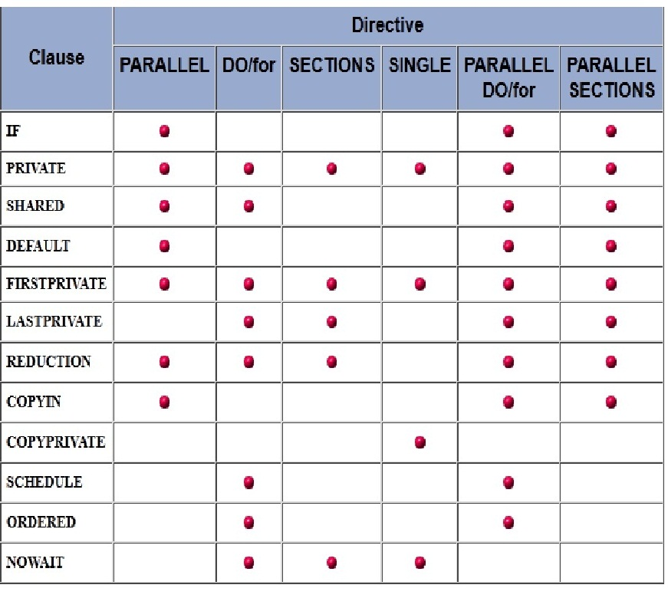
Clauses / Directives Summary
The table below summarizes which clauses are accepted by which OpenMP directives.
[<number>]

Slide 122
The following OpenMP directives do not accept clauses:
    MASTER
    CRITICAL
    BARRIER
    ATOMIC
    FLUSH
    ORDERED
    THREADPRIVATE
Implementations may (and do) differ from the standard in which
clauses are supported by each directive.
[<number>]

